Slide 1
Modelling a Thermal Response as 1-DOF Vibratory System
ME
Universtitas Pertamina
2020

Slide 2
Intended Learning Outcomes
Students can derive the mathematical model of a thermal system by using data-driven methods.
Students can simulate a thermal system and compare the simulation to the real process.
Student can analyze the derived model and gain knowledge on the real system through the model.
Students can understand the analogy of a vibratory system and a thermal system.

Slide 3
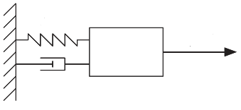






1-DOF Vibartory System
A 1-DOF vibartory system with input delay:
$$M\frac{d^{2}T(t)}{dt}+B\frac{dT(t)}{dt}+KT=u\left(t−θ\right)$$
$$K$$
$$u\left(t−θ\right)$$
$$M$$
$$B$$
$$T$$

Slide 4
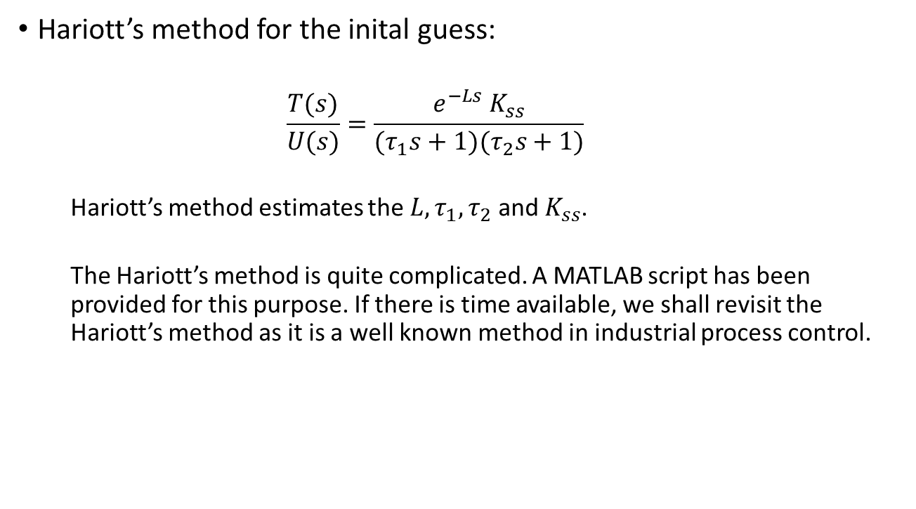
Hariott’s Method for an Overdamped Second Order System
Hariott’s method for the inital guess:
$$\frac{T(s)}{U(s)}=\frac{e^{−Ls}{ K}_{ss}}{(τ_{1}s+1)(τ_{2}s+1)}$$
Hariott’s method estimates the $L,τ_{1},τ_{2}$ and $K_{ss}$.
The Hariott’s method is quite complicated. A MATLAB script has been provided for this purpose. If there is time available, we shall revisit the Hariott’s method as it is a well known method in industrial process control.

Slide 5
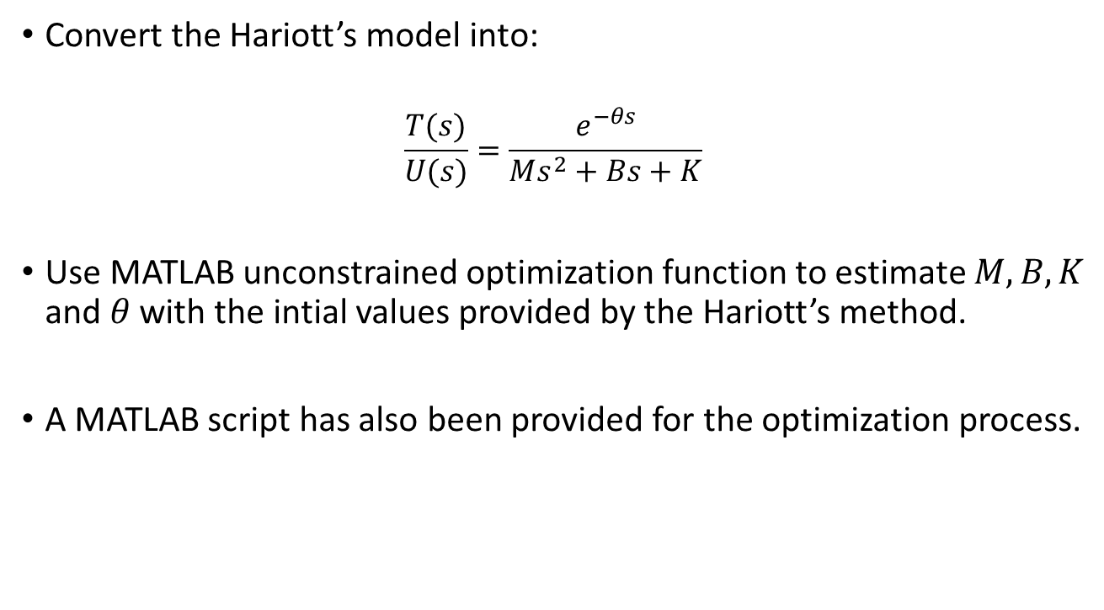
Parameter Optimization for the Vibratory System
Convert the Hariott’s model into:
$$\frac{T(s)}{U(s)}=\frac{e^{−θs}}{Ms^{2}+Bs+K}$$
Use MATLAB unconstrained optimization function to estimate $M, B, K$ and $θ$ with the intial values provided by the Hariott’s method.
A MATLAB script has also been provided for the optimization process.

Slide 6






The Optimized Parameters
$$M=1622.5 Ns^{2}/°C$$
$$B=186.8Ns/°C$$
$$K=0.9 N/°C$$
$$θ=10.2 s$$
Do the units look funny?
$$K$$
$$u\left(t−θ\right)$$
$$M$$
$$B$$
$$T(t)$$

Slide 7
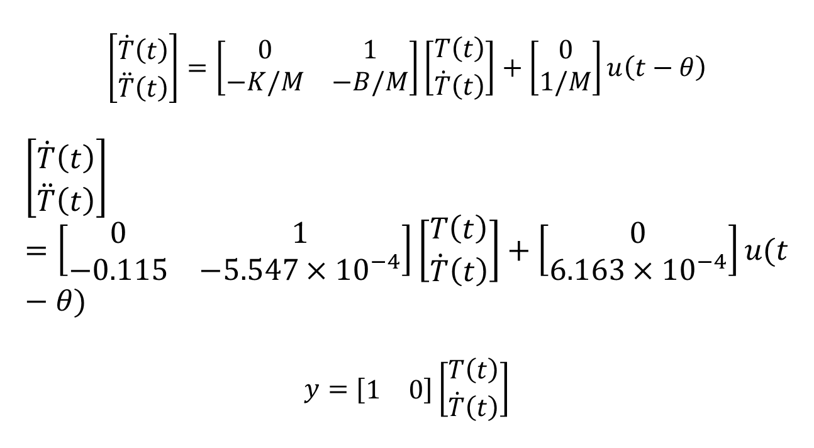
State-Space Form
$$\left[\begin{matrix}\dot{T}\left(t\right) \\ \ddot{T}\left(t\right)\end{matrix}\right]=\left[\begin{matrix}0 & 1 \\ −K/M & −B/M\end{matrix}\right]\left[\begin{matrix}T\left(t\right) \\ \dot{T}\left(t\right)\end{matrix}\right]+\left[\begin{matrix}0 \\ 1/M\end{matrix}\right]u\left(t−θ\right)$$
$$\left[\begin{matrix}\dot{T}\left(t\right) \\ \ddot{T}\left(t\right)\end{matrix}\right]=\left[\begin{matrix}0 & 1 \\ −0.115 & −5.547×{10}^{−4}\end{matrix}\right]\left[\begin{matrix}T\left(t\right) \\ \dot{T}\left(t\right)\end{matrix}\right]+\left[\begin{matrix}0 \\ 6.163×{10}^{−4}\end{matrix}\right]u(t−θ)$$
$$y=[\begin{matrix}1 & 0\end{matrix}]\left[\begin{matrix}T\left(t\right) \\ \dot{T}\left(t\right)\end{matrix}\right]$$

Slide 8
Hariott’s method actually works very well!

Slide 9
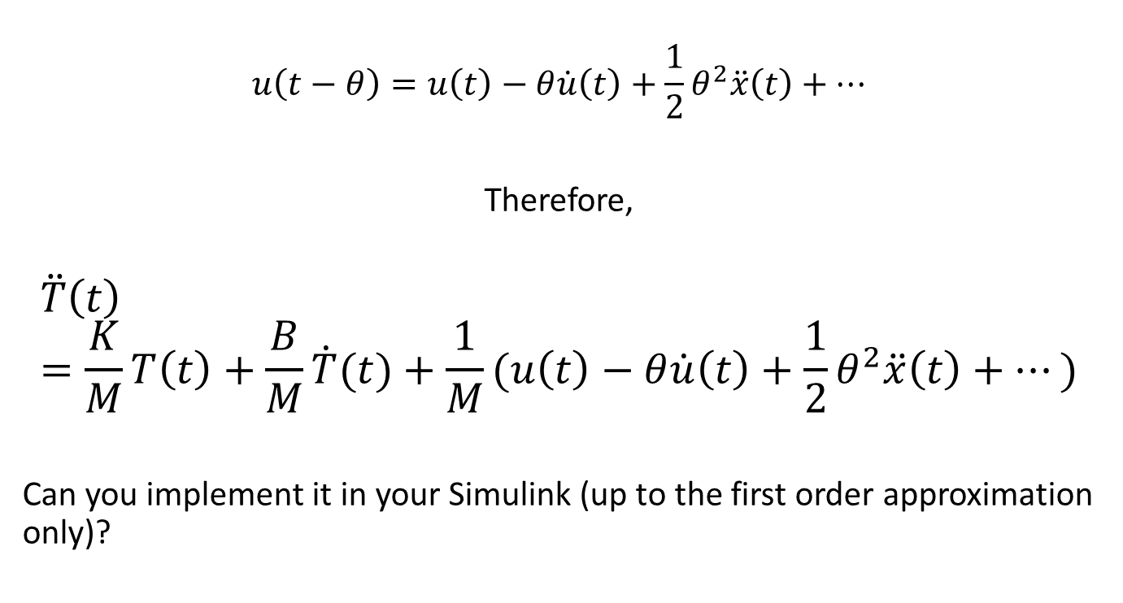
Approximation of the Delayed System by Taylor Series Expansion
$$u\left(t−θ\right)=u\left(t\right)−θ\dot{u}\left(t\right)+\frac{1}{2}θ^{2}\ddot{x}\left(t\right)+⋯$$
Therefore,
$$\ddot{T}\left(t\right)=\frac{K}{M}T\left(t\right)+\frac{B}{M}\dot{T}(t)+\frac{1}{M}(u\left(t\right)−θ\dot{u}\left(t\right)+\frac{1}{2}θ^{2}\ddot{x}\left(t\right)+⋯)$$
Can you implement it in your Simulink (up to the first order approximation only)?

Slide 10
Further Ideas
What can we do with this vibratory model?
Think of something, write them down in your report.

Slide 11
Activity
Apply a step input to your system, i.e. 50% PWM input
Log both data, input and output. It is also recommended to log the time.
Check the provided m-files: for the Hariott method and for the optimization process.
With the found parameters, simulate the system side-by-side with the actual system. Apply any arbitrary input and observe the output.

Slide 12
Activity
Calculate the RMS eror between the simulation and the real system. Provide the plots in your report. Report the parameters of your system too.
A Google sheet will be provided where everyone can report their parameters. We will see how different these parameters are among groups.

